Slide 1
Mining Frequent Patterns without Candidate Generation
SIGMOD 2000
Jiawei Han , Jian Pei , and Yiwen Yin
School of Computing Science
Simon Fraser University
Author: Mohammed Al-kateb
Presenter: Zhenyu Lu (with some changes)

Slide 2
Frequent Pattern Mining
Problem
Given a transaction database DB and a minimum support threshold ξ, find all frequent patterns (item sets) with support no less than ξ.
Input:
DB:
TID Items bought
100 {f, a, c, d, g, i, m, p}
200 {a, b, c, f, l, m, o}
300 {b, f, h, j, o}
400 {b, c, k, s, p}
500 {a, f, c, e, l, p, m, n}
Minimum support: ξ =3
Output:
all frequent patterns, i.e., f, a, …, fa, fac, fam, …
Problem: How to efficiently find all frequent patterns?
Mining Frequent Patterns without Candidate Generation (SIGMOD2000)

Slide 3
Outline
Review:
  Apriori-like methods
Overview:
  FP-tree based mining method
FP-tree:
  Construction, structure and advantages
FP-growth:
  FP-tree →conditional pattern bases → conditional FP-tree
  →frequent patterns
Experiments
Discussion:
  Improvement of FP-growth
Conclusion
Mining Frequent Patterns without Candidate Generation (SIGMOD2000)

Slide 4
Apriori
Review
The core of the Apriori algorithm:
  Use frequent (k – 1)-itemsets (L_{k-1}) to generate candidates of frequent k-itemsets C_{k}
  Scan database and count each pattern in C_{k} , get frequent k-itemsets ( L_{k} ) .
E.g.,
TID Items bought
100 {f, a, c, d, g, i, m, p}
200 {a, b, c, f, l, m, o}
300 {b, f, h, j, o}
400 {b, c, k, s, p}
500 {a, f, c, e, l, p, m, n}
Apriori iteration
C1 f,a,c,d,g,i,m,p,l,o,h,j,k,s,b,e,n
L1 f, a, c, m, b, p
C2 fa, fc, fm, fp, ac, am, …bp
L2 fa, fc, fm, …
…
Mining Frequent Patterns without Candidate Generation (SIGMOD2000))

Slide 5
Performance Bottlenecks of Apriori
Review
The bottleneck of Apriori: candidate generation
  Huge candidate sets:
    10⁴ frequent 1-itemset will generate 10⁷ candidate 2-itemsets
    To discover a frequent pattern of size 100, e.g., {a₁, a₂, …, a₁₀₀}, one needs to generate 2¹⁰⁰ ≈ 10³⁰ candidates.
  Multiple scans of database: each candidate
Mining Frequent Patterns without Candidate Generation (SIGMOD2000)

Slide 6
Ideas
Overview: FP-tree based method
Compress a large database into a compact, Frequent-Pattern tree (FP-tree) structure
  highly condensed, but complete for frequent pattern mining
  avoid costly database scans
Develop an efficient, FP-tree-based frequent pattern mining method (FP-growth)
  A divide-and-conquer methodology: decompose mining tasks into smaller ones
  Avoid candidate generation: sub-database test only.
Mining Frequent Patterns without Candidate Generation (SIGMOD2000))

Slide 7
FP-tree:
Design and Construction
Mining Frequent Patterns without Candidate Generation (SIGMOD2000)

Slide 8
Construct FP-tree
FP-tree
2 Steps:
Scan the transaction DB for the first time, find frequent items (single item patterns) and order them into a list L in frequency descending order.
e.g., L={f:4, c:4, a:3, b:3, m:3, p:3}
note: in “f:4”, “4” is the support of “f”
2. For each transaction, order its frequent items according to the order in L; Scan DB the second time, construct FP-tree by putting each frequency ordered transaction onto it
Mining Frequent Patterns without Candidate Generation (SIGMOD2000)

Slide 9
FP-tree
FP-tree Example: step 1
Step 1: Scan DB for the first time to generate L
L
TID Items bought
100 {f, a, c, d, g, i, m, p}
200 {a, b, c, f, l, m, o}
300 {b, f, h, j, o}
400 {b, c, k, s, p}
500 {a, f, c, e, l, p, m, n}
Item frequency
f 4
c 4
a 3
b 3
m 3
p 3
Mining Frequent Patterns without Candidate Generation (SIGMOD2000)

Slide 10
FP-tree
FP-tree Example: step 2
Step 2: scan the DB for the second time, order frequent items in each transaction
TID Items bought (ordered) frequent items
100 {f, a, c, d, g, i, m, p} {f, c, a, m, p}
200 {a, b, c, f, l, m, o} {f, c, a, b, m}
300 {b, f, h, j, o} {f, b}
400 {b, c, k, s, p} {c, b, p}
500 {a, f, c, e, l, p, m, n} {f, c, a, m, p}
Mining Frequent Patterns without Candidate Generation (SIGMOD2000)

Slide 11
FP-tree
FP-tree Example: step 2
Step 2: construct FP-tree
{}
{}
f:1
f:2
{f, c, a, m, p}
{f, c, a, b, m}
{}
c:1
c:2
a:1
a:2
m:1
m:1
b:1
p:1
p:1
m:1
Mining Frequent Patterns without Candidate Generation (SIGMOD2000)

Slide 12
FP-tree
FP-tree Example: step 2
Step 2: construct FP-tree
{}
{}
{}
f:3
f:3
c:1
f:4
c:1
{f, b}
{c, b, p}
{f, c, a, m, p}
c:2
b:1
c:2
b:1
b:1
c:3
b:1
b:1
a:2
a:2
p:1
a:3
p:1
m:1
b:1
m:1
b:1
m:2
b:1
p:1
m:1
p:1
m:1
p:2
m:1
Mining Frequent Patterns without Candidate Generation (SIGMOD2000)

Slide 13
FP-tree
Construction Example
the resulting FP-tree
{}
Header Table
Item head
f
c
a
b
m
p
f:4
c:1
c:3
b:1
b:1
a:3
p:1
m:2
b:1
p:2
m:1
Mining Frequent Patterns without Candidate Generation (SIGMOD2000)

Slide 14
FP-Tree Definition
FP-tree
FP-tree is a frequent pattern tree (the short answer). Formally, FP-tree is a tree structure defined below:
1. It consists of one root labeled as “null", a set of item prefix subtrees as the children of the root, and a frequent-item header table.
2. Each node in the item prefix subtrees has three fields:
  item-name to register which item this node represents,
  count, the number of transactions represented by the portion of the path reaching this node, and
  node-link that links to the next node in the FP-tree carrying the same item-name, or null if there is none.
3. Each entry in the frequent-item header table has two fields,
  item-name, and
  head of node-link that points to the first node in the FP-tree carrying the item-name.
Mining Frequent Patterns without Candidate Generation (SIGMOD2000)

Slide 15
Advantages of the FP-tree Structure
FP-tree
The most significant advantage of the FP-tree
  Scan the DB only twice.
Completeness:
  the FP-tree contains all the information related to mining frequent patterns (given the min_support threshold)
Compactness:
  The size of the tree is bounded by the occurrences of frequent items
  The height of the tree is bounded by the maximum number of items in a transaction
Mining Frequent Patterns without Candidate Generation (SIGMOD2000)

Slide 16
Questions?
FP-tree
Why descending order?
Example 1:
{}
f:1
a:1
TID (unordered) frequent items
100 {f, a, c, m, p}
500 {a, f, c, p, m}
a:1
f:1
c:1
c:1
m:1
p:1
p:1
m:1
Mining Frequent Patterns without Candidate Generation (SIGMOD2000)

Slide 17
Questions?
FP-tree
Example 2:
{}
TID (ascended) frequent items
100 {p, m, a, c, f}
200 {m, b, a, c, f}
300 {b, f}
400 {p, b, c}
500 {p, m, a, c, f}
p:3
m:2
c:1
m:2
b:1
b:1
b:1
a:2
c:1
a:2
p:1
This tree is larger than FP-tree, because in FP-tree, more frequent items have a higher position, which makes branches less
c:2
c:1
f:2
f:2
Mining Frequent Patterns without Candidate Generation (SIGMOD2000)

Slide 18
FP-growth:
Mining Frequent Patterns
Using FP-tree
Mining Frequent Patterns without Candidate Generation (SIGMOD2000)

Slide 19
Mining Frequent Patterns Using FP-tree
FP-Growth
General idea (divide-and-conquer)
Recursively grow frequent patterns using the FP-tree: looking for shorter ones recursively and then concatenating the suffix:
  For each frequent item, construct its conditional pattern base, and then its conditional FP-tree;
  Repeat the process on each newly created conditional FP-tree until the resulting FP-tree is empty, or it contains only one path (single path will generate all the combinations of its sub-paths, each of which is a frequent pattern)
Mining Frequent Patterns without Candidate Generation (SIGMOD2000)

Slide 20
3 Major Steps
FP-Growth
Starting the processing from the end of list L:
Step 1:
  Construct conditional pattern base for each item in the header table
Step 2
  Construct conditional FP-tree from each conditional pattern base
Step 3
  Recursively mine conditional FP-trees and grow frequent patterns obtained so far. If the conditional FP-tree contains a single path, simply enumerate all the patterns
Mining Frequent Patterns without Candidate Generation (SIGMOD2000)

Slide 21
Step 1: Construct Conditional Pattern Base
FP-Growth
Starting at the bottom of frequent-item header table in the FP-tree
Traverse the FP-tree by following the link of each frequent item
Accumulate all of transformed prefix paths of that item to form a conditional pattern base
{}
Conditional pattern bases
item cond. pattern base
p fcam:2, cb:1
m fca:2, fcab:1
b fca:1, f:1, c:1
a fc:3
c f:3
f { }
Header Table
Item head
f
c
a
b
m
p
f:4
c:1
c:3
b:1
b:1
a:3
p:1
m:2
b:1
p:2
m:1
Mining Frequent Patterns without Candidate Generation (SIGMOD2000)

Slide 22
Properties of Step 1
FP-Growth
Node-link property
  For any frequent item a_{i}, all the possible frequent patterns that contain a_{i} can be obtained by following a_{i}'s node-links, starting from a_{i}'s head in the FP-tree header.
Prefix path property
  To calculate the frequent patterns for a node a_{i} in a path P, only the prefix sub-path of a_{i} in P need to be accumulated, and its frequency count should carry the same count as node a_{i}.
Mining Frequent Patterns without Candidate Generation (SIGMOD2000)

Slide 23
Step 2: Construct Conditional FP-tree
FP-Growth
For each pattern base
  Accumulate the count for each item in the base
  Construct the conditional FP-tree for the frequent items of the pattern base
{}
Header Table
Item head
f 4
c 4
a 3
b 3
m 3
p 3
f:4
{}
c:3
f:3
m- cond. pattern base:
  fca:2, fcab:1
a:3


c:3
m:2
b:1
a:3
m:1
m-conditional FP-tree
Mining Frequent Patterns without Candidate Generation (SIGMOD2000)

Slide 24
Conditional Pattern Bases and
Conditional FP-Tree
FP-Growth
Item
Conditional pattern base
Conditional FP-tree
p
{(fcam:2), (cb:1)}
{(c:3)}|p
m
{(fca:2), (fcab:1)}
{(f:3, c:3, a:3)}|m
b
{(fca:1), (f:1), (c:1)}
Empty
a
{(fc:3)}
{(f:3, c:3)}|a
c
{(f:3)}
{(f:3)}|c
f
Empty
Empty
order of L
Mining Frequent Patterns without Candidate Generation (SIGMOD2000)

Slide 25
Step 3: Recursively mine the conditional FP-tree
FP-Growth
conditional FP-tree of
“m”: (fca:3)
conditional FP-tree of
“am”: (fc:3)
conditional FP-tree of
“cam”: (f:3)
add
“c”
{}
{}
{}
add
“a”
Frequent Pattern
Frequent Pattern
Frequent Pattern
f:3
f:3
f:3
c:3
add
“f”
add
“c”
add
“f”
c:3
conditional FP-tree of
“cm”: (f:3)
conditional FP-tree of
of “fam”: 3
a:3
{}
add
“f”
Frequent Pattern
Frequent Pattern
add
“f”
f:3
conditional FP-tree of
“fcm”: 3
Frequent Pattern
Frequent Pattern
fcam
conditional FP-tree of “fm”: 3
Mining Frequent Patterns without Candidate Generation (SIGMOD2000)
Frequent Pattern

Slide 26
Principles of FP-Growth
FP-Growth
Pattern growth property
  Let α be a frequent itemset in DB, B be α's conditional pattern base, and β be an itemset in B. Then α ∪ β is a frequent itemset in DB iff β is frequent in B.
Is “fcabm ” a frequent pattern?
  “fcab” is a branch of m's conditional pattern base
  “b” is NOT frequent in transactions containing “fcab ”
  “bm” is NOT a frequent itemset.
Mining Frequent Patterns without Candidate Generation (SIGMOD2000)

Slide 27
Single FP-tree Path Generation
FP-Growth
Suppose an FP-tree T has a single path P. The complete set of frequent pattern of T can be generated by enumeration of all the combinations of the sub-paths of P
{}
All frequent patterns concerning m: combination of {f, c, a} and m
m,
fm, cm, am,
fcm, fam, cam,
fcam
f:3

c:3
a:3
m-conditional FP-tree
Mining Frequent Patterns without Candidate Generation (SIGMOD2000)

Slide 28
Efficiency Analysis
FP-Growth
Facts: usually
  FP-tree is much smaller than the size of the DB
  Pattern base is smaller than original FP-tree
  Conditional FP-tree is smaller than pattern base
  ➔ mining process works on a set of usually much smaller pattern bases and conditional FP-trees
  Divide-and-conquer and dramatic scale of shrinking
Mining Frequent Patterns without Candidate Generation (SIGMOD2000)

Slide 29
Experiments:
Performance Assessment
Mining Frequent Patterns without Candidate Generation (SIGMOD2000)

Slide 30
Experiment Setup
Experiments
Compare the runtime of FP-growth with classical Apriori and recent TreeProjection
  Runtime vs. min_sup
  Runtime per itemset vs. min_sup
  Runtime vs. size of the DB (# of transactions)
Synthetic data sets : frequent itemsets grows exponentially as minisup goes down
  D1: T25.I10.D10K
    1K items
    avg(transaction size)=25
    avg(max/potential frequent item size)=10
    10K transactions
  D2: T25.I20.D100K
    10k items
Mining Frequent Patterns without Candidate Generation (SIGMOD2000)

Slide 31
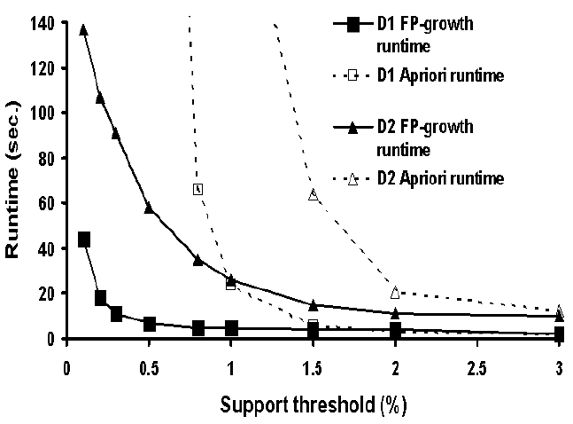
Scalability: runtime vs. min_sup
(w/ Apriori)
Experiments
Mining Frequent Patterns without Candidate Generation (SIGMOD2000)

Slide 32
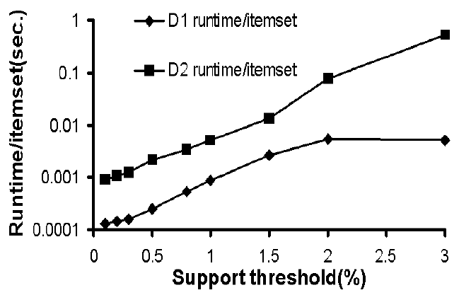
Runtime/itemset vs. min_sup
Experiments
Mining Frequent Patterns without Candidate Generation (SIGMOD2000)
Notes:
Experimental Evaluation and Performance Study (Continue)
FP-growth is about an order of magnitude faster than Apriori in large databases.
This Gap grows wider when the minimum support threshold reduces.

Slide 33
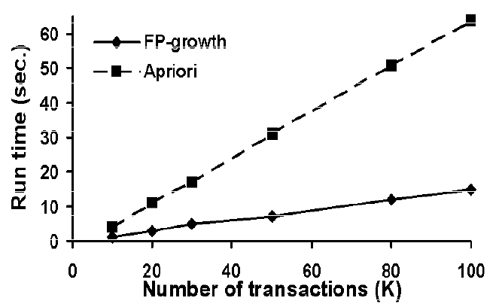
Scalability: runtime vs. # of Trans.
(w/ Apriori)
Experiments
* Using D2 and min_support=1.5%
Mining Frequent Patterns without Candidate Generation (SIGMOD2000)

Slide 34
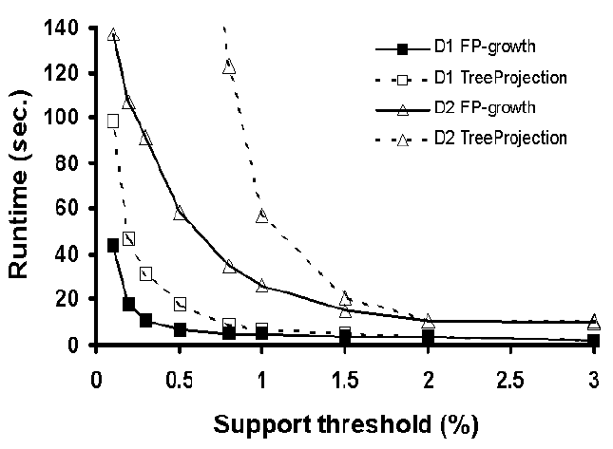
Scalability: runtime vs. min_support
(w/ TreeProjection)
Experiments
Mining Frequent Patterns without Candidate Generation (SIGMOD2000)

Slide 35
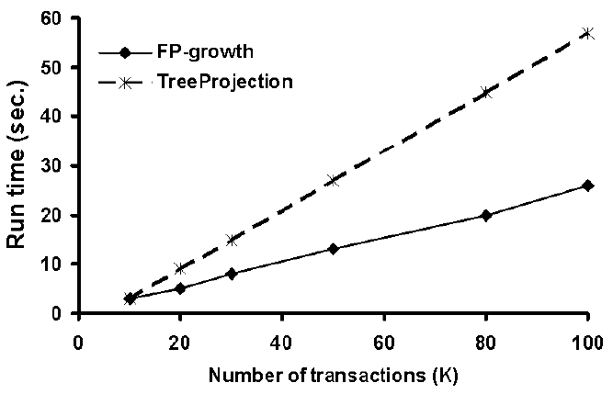
Scalability: runtime vs. # of Trans.
(w/ TreeProjection)
Experiments
Support = 1%
Mining Frequent Patterns without Candidate Generation (SIGMOD2000)

Slide 36
Discussions:
Improve the performance
and scalability of FP-growth
Mining Frequent Patterns without Candidate Generation (SIGMOD2000)

Slide 37
Performance Improvement
Discussion
Projected DBs
Disk-resident
FP-tree
FP-tree
Materialization
FP-tree
Incremental update
partition the DB into a set of projected DBs and then construct an FP-tree and mine it in each projected DB.
Store the FP-tree in the hark disks by using B+tree structure to reduce I/O cost.
a low ξ may usually satisfy most of the mining queries in the FP-tree construction.
How to update an FP-tree when there are new data?
  Re-construct the FP-tree
  Or do not update the FP-tree
Mining Frequent Patterns without Candidate Generation (SIGMOD2000)

Slide 38
Conclusion
FP-tree: a novel data structure for storing compressed, crucial information about frequent patterns
FP-growth: an efficient mining method of frequent patterns in large database: using a highly compact FP-tree, avoiding candidate generation and applying divide-and-conquer method.
Mining Frequent Patterns without Candidate Generation (SIGMOD2000)

Slide 39
Related info.
FP_growth method is (year 2000) available in DBMiner.
Original paper appeared in SIGMOD 2000. The extended version was just published: “Mining Frequent Patterns without Candidate Generation: A Frequent-Pattern Tree Approach” Data Mining and Knowledge Discovery, 8, 53–87, 2004. Kluwer Academic Publishers.
Textbook: “Data Ming: Concepts and Techniques” Chapter 6.2.4 (Page 239~243)
Mining Frequent Patterns without Candidate Generation (SIGMOD2000)

Slide 40
Exams Questions
Q1: What is FP-Tree?
Previous answer: FP-Tree (stands for Frequent Pattern Tree) is a compact data structure, which is an extended prefix-tree structure. It holds quantitative information about frequent patterns. Only frequent length-1 items will have nodes in the tree, and the tree nodes are arranged in such a way that more frequently occurring nodes will have better chances of sharing nodes than less frequently occurring ones.
My answer: A FP-Tree is a tree data structure that represents the
database in a compact way. It is constructed by mapping each frequency
ordered transaction onto a path in the FP-Tree.
Mining Frequent Patterns without Candidate Generation (SIGMOD2000)

Slide 41
Exams Questions
Q2: What is the most significant advantage of FP-Tree?
A: Efficiency, the most significant advantage of the FP-tree is that it requires two scans to the underlying database (and only two scans) to construct the FP-tree.
Mining Frequent Patterns without Candidate Generation (SIGMOD2000)

Slide 42
Exams Questions
Q3: How to update a FP tree when there are new data?
A: Using the idea of watermarks
In the general case, we can register the occurrence frequency of every item in F1 and track them in updates. This is not too costly but it benefits the incremental updates of an FP-tree as follows:
Suppose a FP-tree was constructed based on a validity support threshold (called “watermark") = 0.1% in a DB with 10⁸ transactions. Suppose an additional 10⁶ transactions are added in. The frequency of each item is updated. If the highest relative frequency among the originally infrequent items (i.e., not in the FP-tree) goes up to, say 12%, the watermark will need to go up accordingly to > 0.12% to exclude such item(s). However, with more transactions added in, the watermark may even drop since an item's relative support frequency may drop with more transactions added in. Only when the FP-tree watermark is raised to some undesirable level, the reconstruction of the FP-tree for the new DB becomes necessary.
Mining Frequent Patterns without Candidate Generation (SIGMOD2000)

